Slide 1
SUPERSTORE ANALYZE
EXCEL + SQL

Slide 2
OBJECTIVE
Analyze the dataset containing sales transaction information from a retail business. The goal is to perform comprehensive data analysis, extract meaningful insights, and create interactive visualizations using Microsoft Excel and also creating a table and removing unwanted data using code in SQL.

Slide 3
Excel
There are 9995 rows and 21 columns.
Used power query to edit the dataset for clear insights.
Added Data visualizations like line chart,pie chart,Bar chart and also slicers for filtering the data.
Created pivot table for clear and concise summarization and also for easy calculations like aggregate function.
Data are calculated by functions like Sum,average,count,minimum, maximum etc…

Slide 4
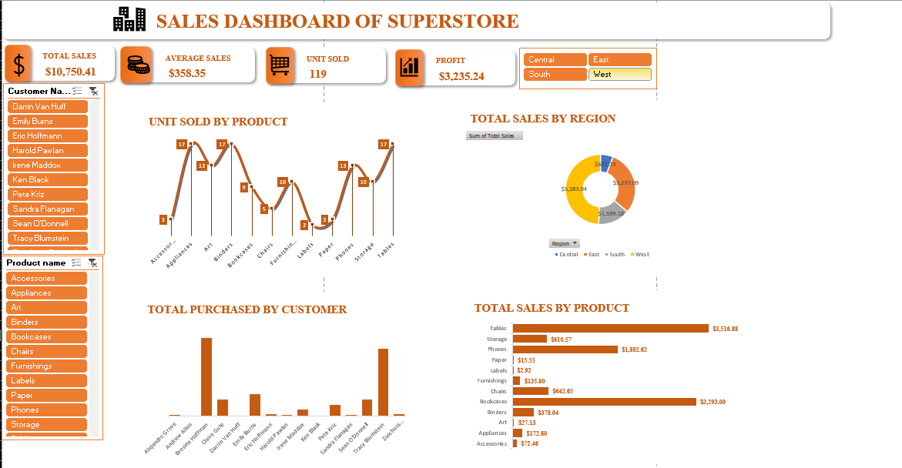
DASHBOARD:

Slide 5
SQL
Connect the Excel dataset into SQL for creating a table.
Create a schema for importing the dataset into that
Altered dataset for the precise insights.

Slide 6

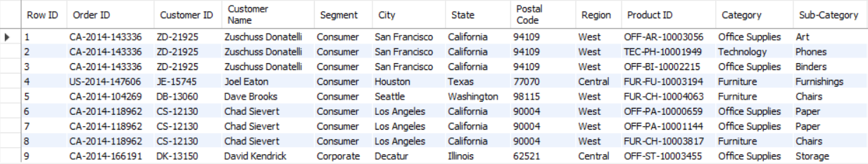
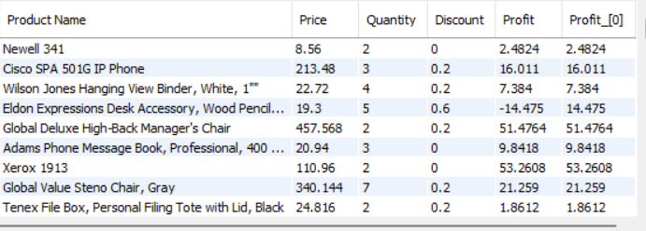
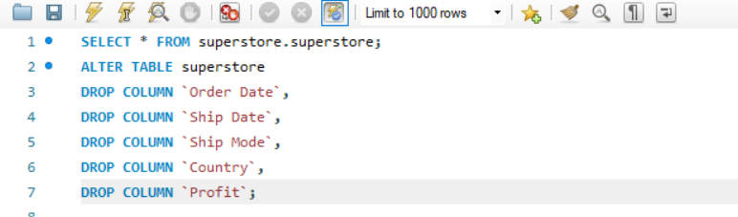
Step 1: Imported dataset
OUTPUT:
Step 2: Removed all unwanted columns

Slide 7
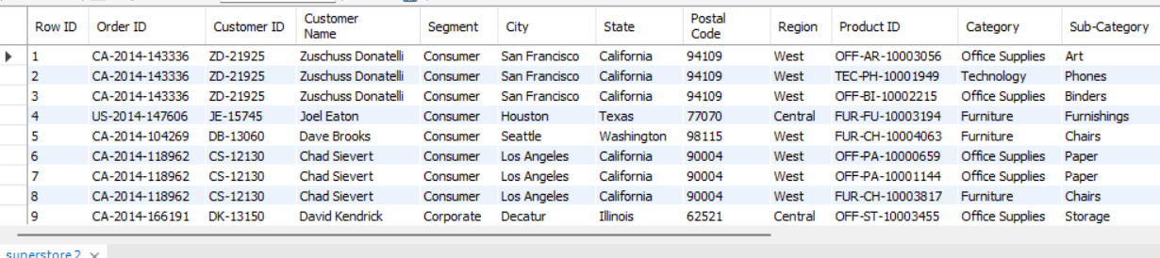
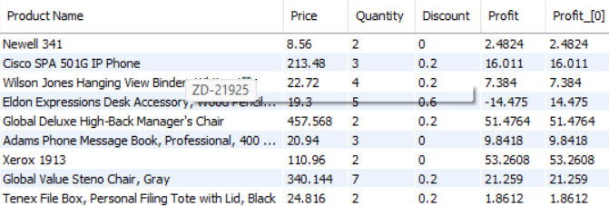
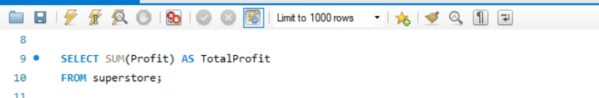


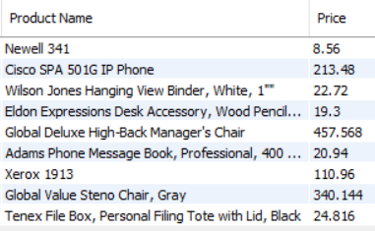
OUTPUT:
Step 3: Sum the Profit as Total profit
OUTPUT:
Step 4: Rename Sales column as a Price
OUTPUT:

Slide 8
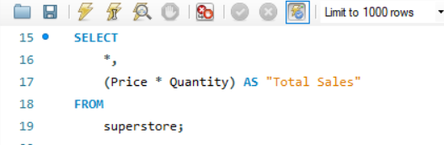
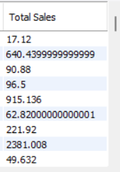
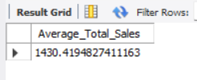
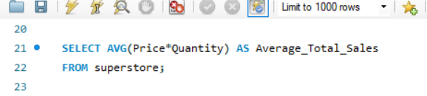
Step 5: Calculated Total Sales
OUTPUT:
Step 6: Calculated Average
OUTPUT:

Slide 9
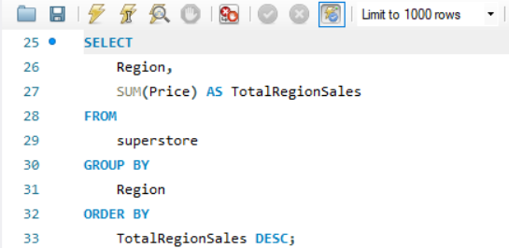
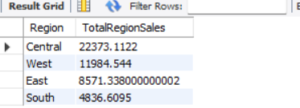
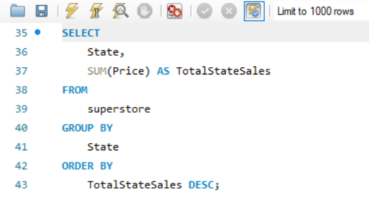
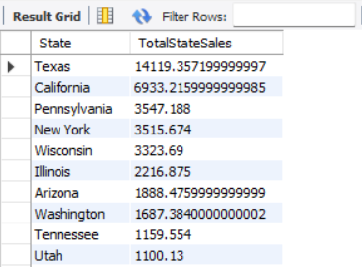
Step 7: Calculated Sales by Region
OUTPUT:
Step 8: Calculated Sales by State
OUTPUT:

Slide 10
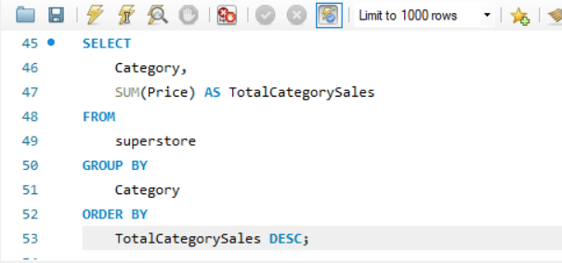
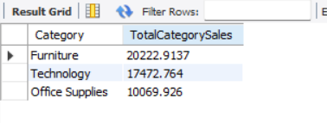
Step 9: Calculated Sales by Country
OUTPUT:

